Slide 1
Personality

Slide 2
Psychodynamic Perspectives
Personality: the unique and relatively stable ways in which people think, feel, and behave
Includes character and temperament
Character: value judgments made about a person’s moral and ethical behavior
Temperament: the enduring characteristics with which each person is born

Slide 3
Four major approaches
Psychoanalytic Approach: The psychoanalytic approach of personality emphasizes the importance of early childhood experiences and the unconscious mind.
This perspective on personality was created by psychiatrist Sigmund Freud who believed that things hidden in the unconscious could be revealed in a number of different ways, including through dreams, free association, and slips of the tongue
For example, a person who experiences anxiety or phobias related to water may have unresolved childhood traumas or conflicts that are surfacing in their adult life, which a psychodynamic therapist would explore and address.

Slide 4
Four major approaches
Humanistic Approach: The humanistic approach of personality focuses on psychological growth, free will, and personal awareness.
It takes a more positive outlook on human nature and is centered on how each person can achieve their individual potential.
For instance, a person who consistently strives to develop their full potential, seeks personal authenticity, and places importance on self-reflection and personal values aligns with the humanistic approach

Slide 5
Four major approaches
Trait Approach: The trait approach of personality is centered on identifying, describing, and measuring the specific traits that make up human personality.﻿
By understanding these traits, researchers believe they can better comprehend the differences between individuals.
For example, if we consider the trait of extraversion, an individual who is outgoing, sociable, and enjoys being around people would be described as having a high level of extraversion

Slide 6
Four major approaches
Social Cognitive Approach: The social cognitive approach of personality emphasizes the importance of observational learning, self-efficacy, situational influences, and cognitive processes.
For example, a person who develops a fear of public speaking due to a negative experience of being embarrassed in front of an audience may exhibit avoidance behaviors and negative self-beliefs, influenced by their environment and past experiences.

Slide 7
Freud’s Conception of Personality
The Structure of the Mind
Freud divided mind into the preconscious, conscious and unconscious
Believed unconscious mind was most important factor in human behavior and personality
Preconscious mind: information is available but not currently conscious
Conscious mind: level aware of immediate surroundings and perceptions
Unconscious mind: level in which thoughts, feelings, memories, and other information that are not easily or voluntarily brought into consciousness are kept

Slide 8
Freud’s Conception of Personality /////psychodynamic approach of psychology
Freud’s Divisions of the Personality
Personality divided into three parts, each existing at one or more levels of consciousness
How parts develop and interact with each other is basis for Freud’s theory
Each part in constant state of conflict with others
Id: devil Superego: angel Ego: person caught in the middle
The id: for example :-if sarah is hungry, the id would drive her to seek food without considering social norms or consequences.
The ego: For example, if Sarah feels hungry but realizes it's not an appropriate time to eat, the ego would delay her gratification until an appropriate mealtime.
The superego: For instance, if Sarah is tempted to steal food when she is hungry, her superego would prevent her from doing so based on the moral principle of respecting others' property

Slide 9
Freud’s Conception of Personality
Ego: part of the personality that develops out of a need to deal with reality; mostly conscious, rational, and logical
Reality principle: principle by which the ego functions; the satisfaction of the demands of the id only when negative consequences will not result
Mind has 3 parts: conscious, unconscious and preconscious
conscious: thoughts and perceptions
preconscious: available to consciousness, e.g. memories and stored knowledge
unconscious: wishes and desires formed in childhood, biological urges. Determines most of behaviour
Personality has 3 components - id, ego & superego
id: unconscious, urges needing instant gratification
ego: develops in childhood, rational. Chooses between id and external demands
superego: conscience, places restrictions on behaviour

Slide 10
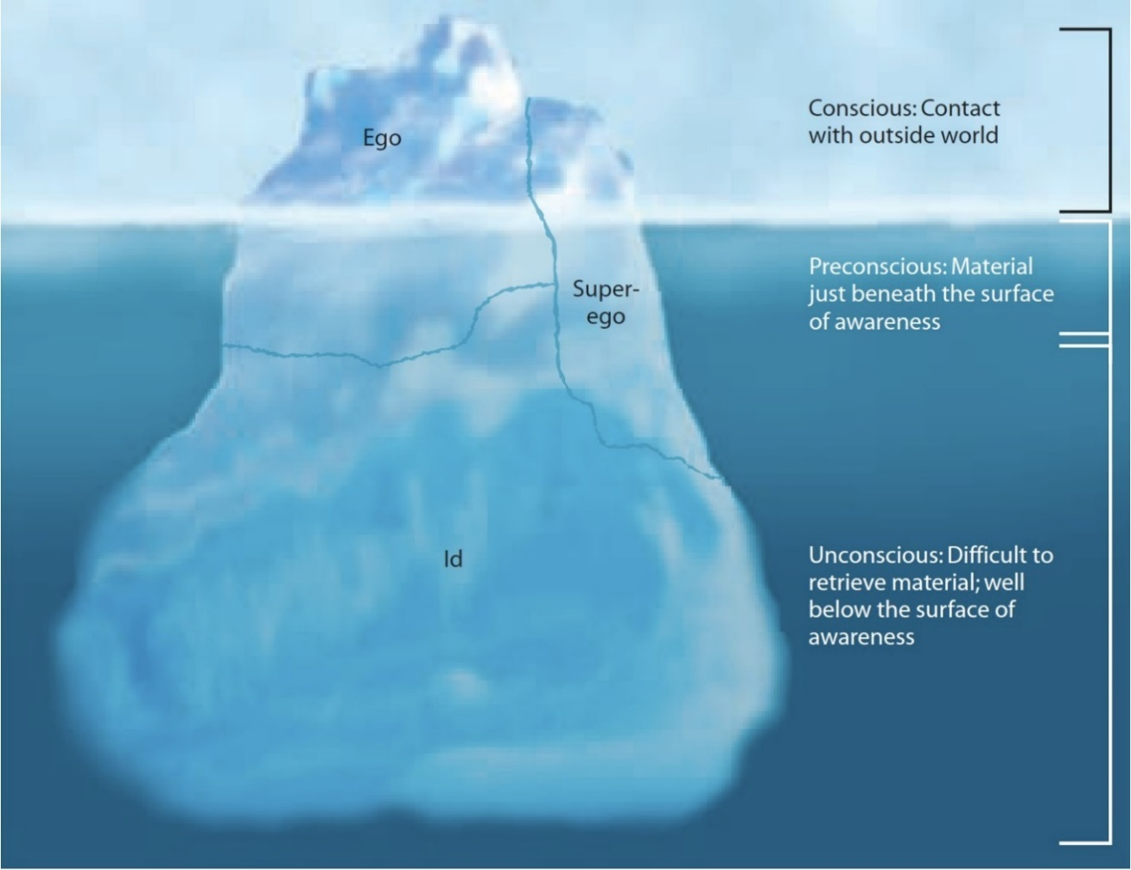
Figure 13.1 Freud’s Conception of the Personality
This iceberg represents the three levels of the mind. The part of the iceberg visible above the surface is the conscious mind. Just below the surface is the preconscious mind, everything that is not yet part of the conscious mind. Hidden deep below the surface is the unconscious mind, feelings, memories, thoughts, and urges that cannot be easily brought into consciousness. While two of the three parts of the personality (ego and superego) exist at all three levels of awareness, the id is completely in the unconscious mind.

Slide 11
Freud’s Conception of Personality
Psychological defense mechanisms: unconscious strategies that individuals use to protect themselves from anxiety, stress, or perceived threat.
Defense Mechanism and Definition | Example
Denial: refusal to recognize or acknowledge a threatening situation. | Renata refuses to acknowledge her son was killed during his recent military deployment.
Repression: “pushing” threatening or conflicting events or situations out of conscious memory. | Regan, who was sexually abused as a child, cannot remember the abuse at all.
Rationalization: making up acceptable excuses for unacceptable behavior. | “If I don’t have breakfast, I can have that piece of cake later on without hurting my diet.”
Projection: placing one’s own unacceptable thoughts onto others, as if the thoughts belonged to them and not to oneself. | Maria is attracted to her sister’s husband but denies this and believes the husband is attracted to her.
Reaction formation: forming an emotional reaction or attitude that is the opposite of one’s threatening or unacceptable actual thoughts. | d square r power 4 PICS

Slide 12
The Psychological Defense Mechanisms
Defense Mechanism and Definition | Example
Displacement: expressing feelings that would be threatening if directed at the real target onto a less threatening substitute target. | Sandra gets reprimanded by her boss and goes home to angrily pick a fight with her husband.
Regression: falling back on childlike patterns as a way of coping with stressful situations. | Four-year-old Blaine starts wetting his bed after his parents bring home a new baby.
Identification: trying to become like someone else to deal with one’s anxiety. | Samantha really admires Emily, the most popular girl in school, and tries to copy her behavior and dress.
Compensation (substitution): trying to make up for areas in which a lack is perceived by becoming superior in some other area. | Ethan is not good at athletics, so he puts all of his energies into becoming an academic scholar.
Sublimation: turning socially unacceptable urges into socially acceptable behavior. | Ryder, who is very aggressive, becomes a mixed martial arts fighter.

Slide 13
The Neo-Freudians
Neo-Freudians: followers of Freud who developed their own competing theories of psychoanalysis
Retained some of Freud’s concepts
But moved away from psychoanalysis to impact of social environment
Jung: developed a theory including both a personal and a collective unconscious
Personal unconscious: Jung’s name for the unconscious mind as described by Freud
Collective unconscious: the memories shared by all members of the human species
Archetypes: collective, universal human memories
Adler: proposed that feelings of inferiority are the driving force behind personality
Developed birth order theory
Firstborn children feel inferior to younger children who receive attention; become overachievers
Middle children feel superior to dethroned older children, as well as younger children; tend to be very competitive
Younger children feel inferior because they don’t have the freedom or responsibility of older children
Horney: developed a theory based on basic anxiety
Basic anxiety: anxiety created when a child is born into the bigger and more powerful world of older children and adults
Neurotic personalities: the result of less-secure upbringings and paired with maladaptive ways of dealing with relationships

Slide 14
Learning Theories
Behaviorists define personality as a set of learned responses or habits
Habit: well-learned response that has become automatic
Watson and Skinner
Social cognitive learning theorists emphasize the influences of other people’s behavior and a person’s own expectancies on learning
Bandura and Rotter
Social cognitive view: learning theory that includes cognitive processes such as anticipating, judging, memory, and imitation of models
Bandura’s reciprocal determinism: explanation of how the factors of environment, personal characteristics, and behavior can interact to determine future behavior
Self-efficacy: an individual’s perception of how effective a behavior will be in any particular circumstance (not the same as self-esteem)

Slide 15
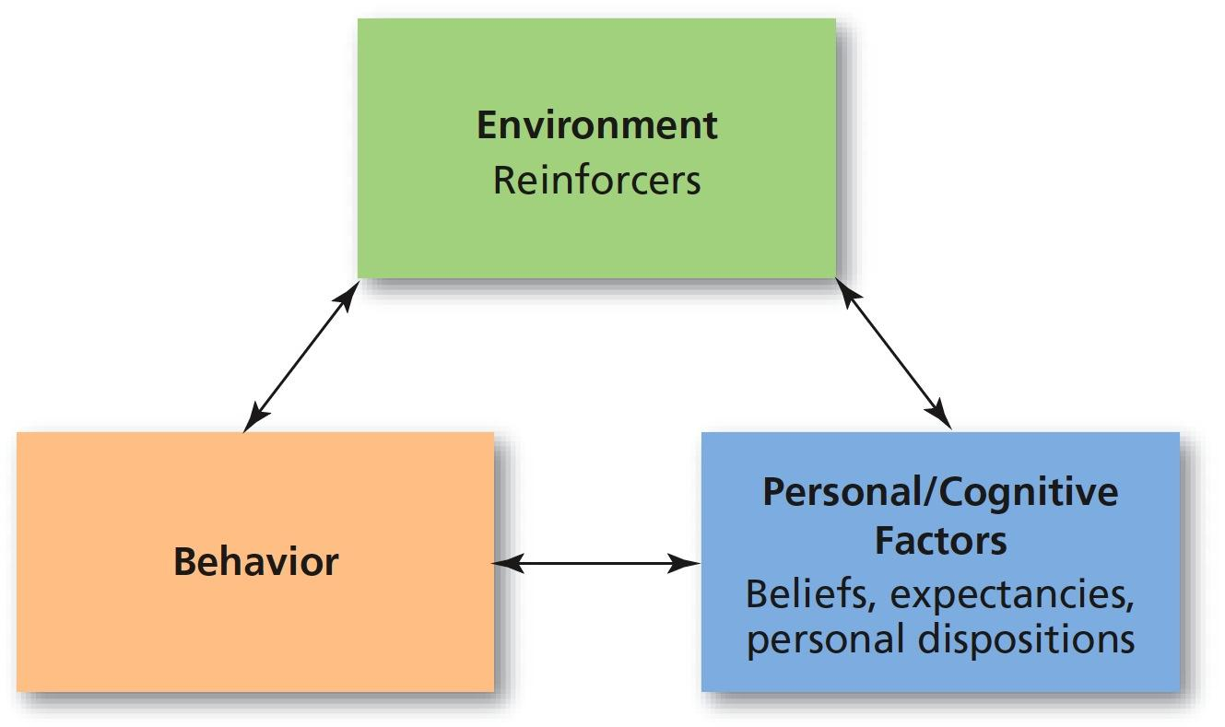
Reciprocal Determinism
In Bandura’s model of reciprocal determinism, three factors influence behavior: the environment, which consists of the physical surroundings and the potential for reinforcement; the person (personal/cognitive characteristics that have been rewarded in the past); and the behavior itself, which may or may not be reinforced at this particular time and place.

Slide 16
Learning Theories
Rotter’s Social Learning Theory: based on principle of motivation
People want to seek reinforcement and avoid punishment
Locus of control: internal vs. external
Expectancy: a person’s subjective feeling that a particular behavior will lead to a reinforcing consequence.

Slide 17
Current Thoughts on the Behavioral and Social Cognitive Learning Views
Behaviorism as explanation of personality formation has limitations
Does not take mental processes into account
Doesn’t give weight to social influences on learning
Social cognitive view includes social and mental processes
Tested under scientific conditions

Slide 18
Carl Rogers and the Humanistic Perspective
Humanistic perspective: the “third force” in psychology
Focuses on aspects of personality that make people uniquely human, such as subjective feelings and freedom of choice
Developed as a reaction against the negativity of psychoanalysis and the deterministic nature of behaviorism
Rogers and Maslow

Slide 19
Carl Rogers and the Humanistic Perspective
Self-actualizing tendency: the striving to fulfill one’s innate capacities and capabilities
Self-concept: the image of oneself that develops from interactions with important, significant people in one’s life
Self-archetype that works with the ego to manage other archetypes and balance the personality

Slide 20
Carl Rogers and the Humanistic Perspective
Real self: one’s perception of actual characteristics, traits, and abilities
Ideal self: one’s perception of whom one should be or would like to be

Slide 21
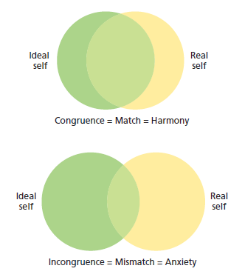
Figure : Real and Ideal Selves
According to Rogers, the self-concept includes the real self and the ideal self. The real self is a person’s actual perception of traits and abilities, whereas the ideal self is the perception of what a person would like to be or thinks he or she should be. When the ideal self and the real self are very similar (matching), the person experiences harmony and contentment. When there is a mismatch between the two selves, the person experiences anxiety and may engage in neurotic behavior.

Slide 22
Carl Rogers and the Humanistic Perspective
Positive regard: warmth, affection, love and respect that come from significant others in one’s life
Unconditional positive regard: positive regard that is given without conditions or strings attached
Conditional positive regard: positive regard that is given only when person doing what providers of positive regard wish
Fully functioning person: a person who is in touch with and trusting of the deepest, innermost urges and feelings

Slide 23
Allport and Cattell: Early Attempts to List and Describe Traits
Trait theories: theories that endeavor to describe the characteristics that make up human personality in an effort to predict future behavior
Trait: a consistent, enduring way of thinking, feeling, or behaving

Slide 24
Allport and Cattell: Early Attempts to List and Describe Traits
Allport first developed a list of about 200 traits; he believed these traits were part of nervous system
Cattell reduced number of traits to 16 (with 7 additional source traits) with a computer method called factor analysis
Developed the 16PF test

Slide 25
Allport and Cattell: Early Attempts to List and Describe Traits
Surface traits: aspects of personality that can easily be seen by other people in the outward actions of a person
Source traits: the more basic traits that underlie the surface traits, forming the core of personality
Example: introversion
Dimension of personality in which people tend to withdraw from excessive stimulation

Slide 26
Modern Trait Theories: The Big Five
Five-factor model (Big Five): basic trait dimensions
Openness: willingness to try new things and be open to new experiences
Conscientiousness: refers to the degree of organization, responsibility, and self-discipline in a person's behavior
Extraversion: one’s need to be with other people
Agreeableness: the emotional style of a person that may range from easygoing, friendly, and likeable to grumpy, crabby, and unpleasant
Neuroticism: degree of emotional instability or stability

Slide 27
Table: The Big Five
Higher Scorer Characteristics | Factor (OCEAN) | Low Scorer Characteristics
Creative, artistic, curious, imaginative | Openness (O) | Conventional, down-to-earth, uncreative nonconforming
Organized, reliable, neat, ambitious | Conscientiousness (C) | Unreliable, lazy, careless, negligent, spontaneous
Talkative, optimistic, sociable, affectionate | Extraversion (E) | Reserved, comfortable being alone, stays in the background
Good-natured, trusting, helpful | Agreeableness (A) | Rude, uncooperative, irritable, aggressive, competitive
Worrying, insecure, anxious, temperamental | Neuroticism (N) | Calm, secure, relaxed, stable
Source: Adapted from McCrae & Costa (1990). | Blank cell | Blank cell

Slide 28
Current Thoughts on the Trait Perspective
Trait-situation interaction: assumption that the particular circumstances of any given situation will influence the way in which a trait is expressed.
Cross-cultural research has found support for five-factor model in all primary cultural regions
Future research will explore the degree to which childrearing practices and heredity may influence the five personality factors

Slide 29
The Biology of Personality: Behavioral Genetics
Behavioral genetics: study of the relationship between heredity and personality
Twin and adoption studies have found support for a genetic influence on many personality traits
Heritability: how much some trait within a population can be attributed to genetic influences, and the extent individual genetic variation impacts differences in observed behavior

Slide 30
The Biology of Personality: Behavioral Genetics
Twin studies
James Arthur Springer and James Edward Lewis, otherwise known as the “Jim” twins, were separated shortly after birth and reunited at age thirty-nine
Exhibited many similarities in personality and personal habits
Minnesota twin study showed identical twins more similar than fraternal twins

Slide 31
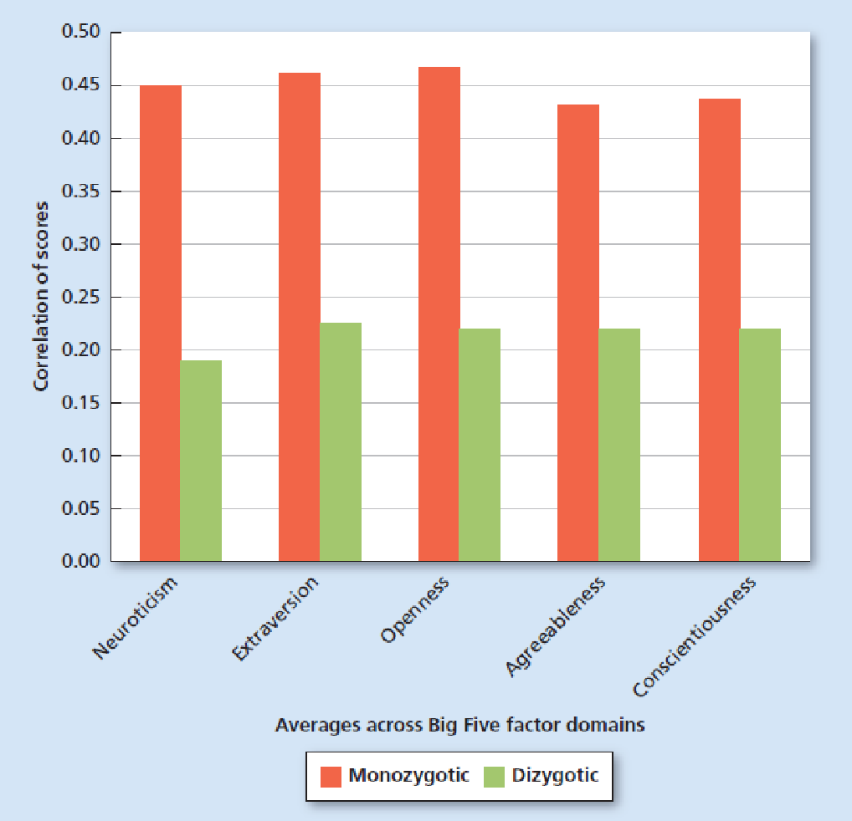
Figure: Personalities of Identical and Fraternal Twins
Identical and fraternal twins differ in the way they express the Big Five personality factors. In a recent study, data from 696 twin pairs suggest identical twins have a correlation of about 45 percent for self-ratings across each of the Big Five factor domains, whereas fraternal twins have a correlation of about 22 percent. These findings give support to the idea that some aspects of personality are genetically based. Based on: Kandler et al. (2010)

Slide 32
Current Findings on the Heritability of Personality
Heritability – how much some trait within a population can be attributed to genetic influences
Studies suggest five personality factors have nearly a 50% rate of heritability
Variations in personality traits 25% to 50% inherited
Environmental influences account for about half of personality traits as well

Slide 33
Interviews, Behavioral Assessments, and Personality Inventories
Behavioral Assessments: behaviorist assumes personality is merely habitually learned responses to stimuli
Direct observation: assessment in which professional observes client engaged in ordinary, day-to-day behavior in either clinical or natural setting
Rating scale
Frequency count

Slide 34
Interviews, Behavioral Assessments, and Personality Inventories
Interview: personality assessment in which professional asks questions of the client and allows client to answer, either in a structured or unstructured fashion
Halo effect: tendency of an interviewer to allow positive characteristics of a client to influence the assessments of the client’s behavior and statements

Slide 35
Interviews, Behavioral Assessments, and Personality Inventories
Personality Inventory: paper-and-pencil or computerized test that consists of statements that require a specific, standardized response from the person taking test
NEO-PI: based on the five-factor model
Myers-Briggs Type Indicator: based on Jung’s theory of personality types
MMPI-2: designed to detect abnormal behavior or thinking patterns in personality

Slide 36
Projective Tests
Projective tests: personality assessments that present ambiguous visual stimuli to the client and ask the client to respond with whatever comes to mind
Rorschach inkblot test: projective test that uses ten inkblots as the ambiguous stimuli
Thematic Apperception Test (TAT): projective test that uses twenty pictures of people in ambiguous situations as the visual stimuli

Slide 37

Figure :Rorschach Inkblot Example
A facsimile of a Rorschach inkblot. A person being tested is asked to tell the interviewer what he or she sees in an inkblot similar to the one shown. Answers are neither right nor wrong but may reveal unconscious concerns. What do you see in this inkblot?

Slide 38
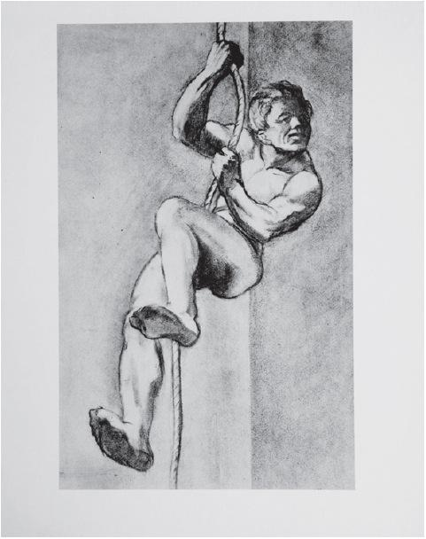
Figure: Thematic Apperception Test Example
A sample from the Thematic Apperception Test (TAT). When you look at this picture, what story does it suggest to you? Who is the person? Why is he climbing a rope?

Slide 39
Projective Tests
Problems with projective tests
Subjective: concepts and impressions that are only valid within a particular person’s perception and may be influenced by biases, prejudice, and personal experiences
With no standard grading scales, projective tests are low in reliability and validity

Slide 40
Table: Who Uses What Method?
Type of Assessment | Most Likely Used by…
Interviews | Psychoanalysts, humanistic therapists
Projective Tests Rorschach Thematic Apperception Test | Psychoanalysts
Behavioral Assessments Direct observation Rating scales Frequency counts | Behavioral and social cognitive therapists
Personality Inventories Sixteen Personality Factor Questionnaire (16PF) Neuroticism/Extraversion/Openness Personality Inventory (NEO-PI-3) Myers-Briggs Type Indicator (MBTI) Eysenck Personality Questionnaire (EPQ) Keirsey Temperament Sorter II California Psychological Inventory (CPI) Minnesota Multiphasic Personality Inventory, Version II, Restructured Form (MMPI-2-RF) | Trait theorists

Slide 41
Determinants of Personality
Environmental Factors
Biological Factors
Situational Factors
Cultural Factors
Social Factors

Slide 42
Determinants: Environmental
Socialization Process: The contribution of family and social group in combination with the culture is knows as socialization.
Identification Process: Identification process occurs when a person tries to identify himself with some person whom he feels ideal in the family. Generally a child in the family tries to behave like his father or mother.

Slide 43
Determinants-Biological
Heredity factors include intelligence level, gender, temperament, various inherited diseases and energy level, physical traits.
) Physical Characteristics

Slide 44
Determinants- Situational
Situational factors do not literally create and shape up an individual‘s personality, situational factors do alter a person‘s behavior and response from time to time.
It can be observed when a person behaves contrastingly and exhibits different traits and characteristics.
For example, a person‘s behavior will be totally different when he is in his office, in front of his boss, when compared to his hangout with old friends in a restaurant.

Slide 45
Determinants- Situational
Positive Behaviors
Loving and respecting yourself.
Standing confident
Believing in yourself
Helping others
Turning negative into positive
Being result oriented
Cutting down negative people from life.
Accepting people the way they are.
Not cribbing over stuffs instead, working for them.
Having faith.
Never losing hope.

Slide 46
Determinants- Situational
b) Negative Behaviors
Excuse making
Blaming and projection
Super-optimism
Super-pessimism
Lying
Making fools of others
Assuming

Slide 47
Determinants- Situational
b) Negative Behaviors (some more)
I'm unique
Vagueness
Aggression / dominance
Power plays
Victim playing
Secretive and close-minded
Isolation

Slide 48
Determinants- Culture and Religion
The culture in which one lives almost always involves:
Traditional practices
Norms
Customs
Rules and regulations
Role Model
Values

Slide 49
Determinants-Social
Social experiences play a vital role in determining one’s personality. The things that occur around a person on a regular basis determine how that person will behave and perceive themselves. A person's social experiences affect:
Social Coordination
Social Cooperation
Family relationships
Workplaces relationships
Community Involvement

